Slide 1


Tarek Ali
October 16, 2022

Slide 2

Outline
Executive Summary
Introduction
Methodology
Results
Conclusion
Appendix

Slide 3
Executive Summary
The following methodologies were used to analyze data:
Data Collection using web scraping and SpaceX API.
Exploratory Data Analysis (EDA), including data wrangling, data visualization and interactive
visual analytics.
Machine Learning Prediction.
Summary of all results:
It was possible to collected valuable data from public sources.
EDA allowed to identify which features are the best to predict success of launchings.
Machine Learning Prediction showed the best model to predict which characteristics are important to drive this opportunity by the best way, using all collected data.

Slide 4
Introduction
Project background and context:
The objective is to evaluate the viability of the new company Space Y to compete with Space X.
Problems you want to find answers:
The best way to estimate the total cost for launches, by predicting successful landings of the first stage of rockets.
Where is the best place to make launches.

Slide 5

Section 1

Slide 6
Methodology
Executive Summary
Data collection methodology:
Space X API (https://api.spacexdata.com/v4/rockets/)
Web Scraping (https://en.wikipedia.org/wiki/List_of_Falcon/_9/_and_Falcon_Heavy_launches
Perform data wrangling
Collected data was enriched by creating a landing outcome label based on outcome data after summarizing and analyzing features
Perform exploratory data analysis (EDA) using visualization and SQL
Perform interactive visual analytics using Folium and Plotly Dash
Perform predictive analysis using classification models “evaluate classification models”

Slide 7
Data Collection
Data sets were collected from:
Space X API (https://api.spacexdata.com/v4/rockets/)
Wikipedia (https://en.wikipedia.org/wiki/List_of_Falcon/_9/_and_Falcon_Heavy_launches).
using web scraping technics.

Slide 8
Data Collection – SpaceX API
SpaceX offers a public API from where data can be obtained and then used;
This API was used according to the flowchart beside and then data is persisted
Source code (https://github.com/tarek-ali20/SpaceX-Falcon-9-first-stage-Landing-Prediction/blob/main/jupyter-labs-spacex-data-collection-api.ipynb )
Request API and
parse the SpaceX
launch data
Filter data to only
include Falcon 9
launcher
Deal with Missing
Values

Slide 9
Data Collection - Scraping
Data from SpaceX launches can also be obtained from Wikipedia
Data are downloaded from Wikipedia according to the flowchart and then persisted.
Request the Falcon9
Launch Wiki page
Extract all column/variable
names from the HTML
table header
Create a data frame by
parsing the launch HTML
tables

Slide 10
Data Wrangling
Initially some Exploratory Data Analysis (EDA) was performed on the dataset.
Then the summaries launches per site, occurrences of each orbit and occurrences of mission outcome per orbit type were calculated.
Finally, the landing outcome label was created from Outcome column
Source code:
https://github.com/tarek-ali20/Space-X-Falcon-9-First-Stage-Land-Data-wrangling-ing-Prediction/blob/main/spacex-Data%20wrangling.ipynb

Slide 11
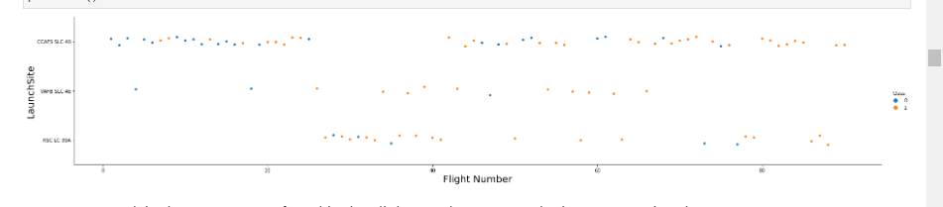
EDA with Data Visualization
To explore data, scatterplots and barplots were used to visualize the relationship between pair of features:
Payload Mass X Flight Number, Launch Site X Flight Number, Launch Site X Payload Mass, Orbit and Flight Number, Payload and Orbit
Source Code : https://github.com/tarek-ali20/SpaceX-Falcon-9-First-Stage-LandinExploring-and-Preparing-Datag-Prediction-/blob/main/eda-dataviz.ipynb

Slide 12
EDA with SQL
The following SQL queries were performed:
• Names of the unique launch sites in the space mission;
• Top 5 launch sites whose name begin with the string 'CCA’;
• Total payload mass carried by boosters launched by NASA (CRS);
• Average payload mass carried by booster version F9 v1.1;
• Date when the first successful landing outcome in ground pad was achieved;
• Total number of successful and failure mission outcomes;
• Names of the booster versions which have carried the maximum payload mass;
Source code :
https://github.com/tarek-ali20/EDA-with-SQL/blob/main/eda-sql-coursera_sqllite.ipynb

Slide 13
Build an Interactive Map with Folium
Markers, circles, lines and marker clusters were used with Folium Maps
• Markers indicate points like launch sites.
• Circles indicate highlighted areas around specific coordinates, like NASA Johnson Space Center.
• Marker clusters indicates groups of events in each coordinate, like launches in a launch site.
• Lines are used to indicate distances between two coordinates.
Code source : https://github.com/tarek-ali20/Launch-Sites-Locations-Analysis-with-Folium

Slide 14
Build a Dashboard with Plotly Dash
The following graphs and plots were used to visualize data
• Percentage of launches by site
• Payload range
This combination allowed to quickly analyze the relation between payloads and launch sites, helping to identify where is best place to launch according to payloads.

Slide 15
Predictive Analysis (Classification)
Four classification models were compared:
logistic regression
support vector machine
decision tree
k nearest neighbors
Code Source : https://labs.cognitiveclass.ai/v2/tools/jupyterlab?ulid=ulid-2563c3f548aca5a9774a3c5b1b4ed8e4809b5c0b

Slide 16
Results
Exploratory data analysis results:
Space X uses 4 different launch sites;.
The first launches were done to Space X itself and NASA.
The average payload of F9 v1.1 booster is 2,928 kg.
The first success landing outcome happened in 2015 fiver year after the first launch.
Many Falcon 9 booster versions were successful at landing in drone ships having payload above the average.
Almost 100% of mission outcomes were successful.
Two booster versions failed at landing in drone ships in 2015: F9 v1.1 B1012 and F9 v1.1 B1015.
The number of landing outcomes became as better as years passed.

Slide 17

Section 2

Slide 18
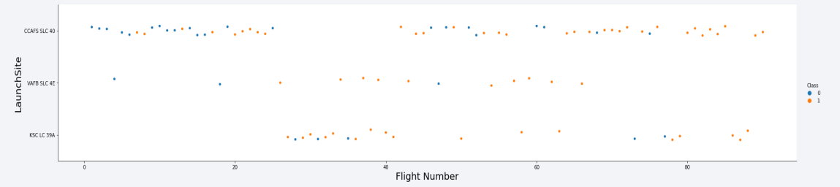
Flight Number vs. Launch Site

Slide 19
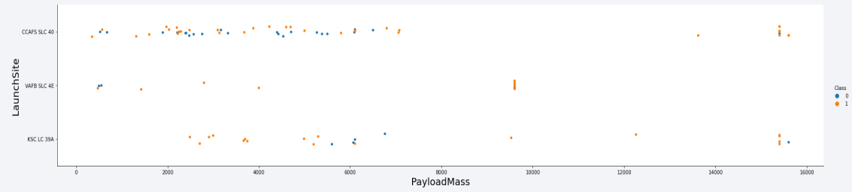
Payload vs. Launch Site

Slide 20
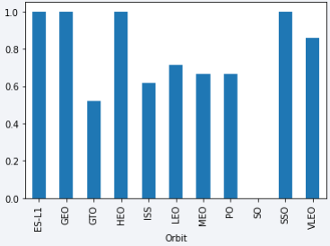
Success Rate vs. Orbit Type

Slide 21
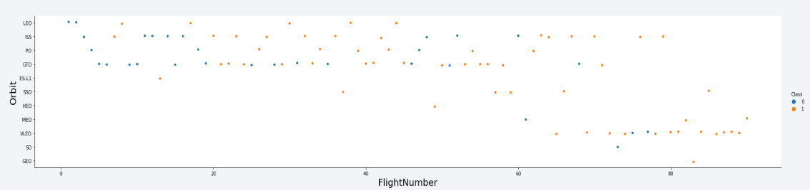
Flight Number vs. Orbit Type

Slide 22
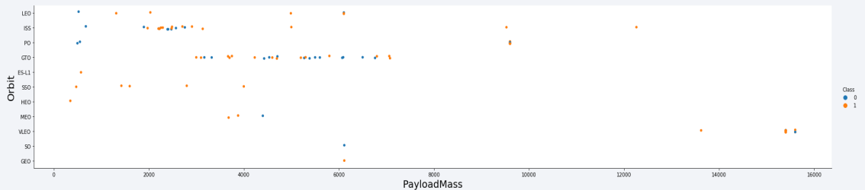
Payload vs. Orbit Type

Slide 23
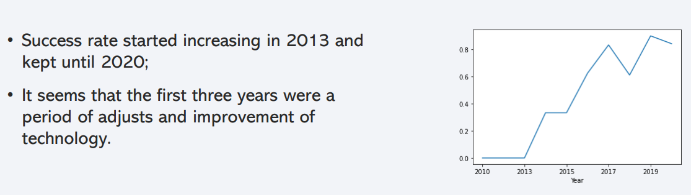
Launch Success Yearly Trend

Slide 24
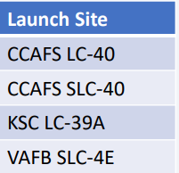
All Launch Site Names
Find the names of the unique launch sites
Present your query result with a short explanation here
They are obtained by selecting unique occurrences of “launch_site” values from the dataset.

Slide 25
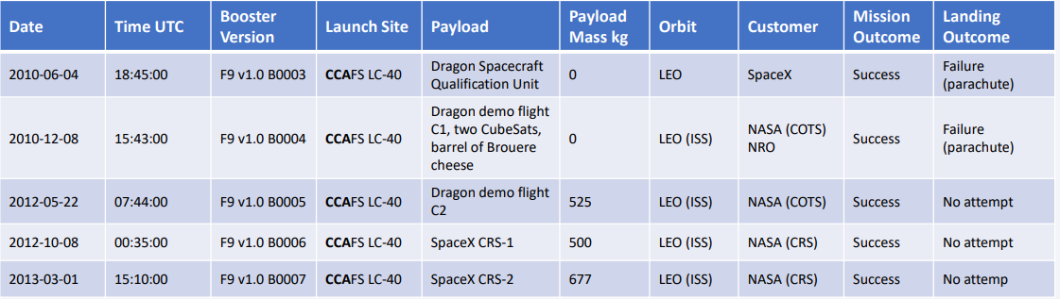
Launch Site Names Begin with 'CCA'
Find 5 records where launch sites begin with `CCA`

Slide 26
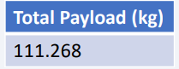
Total Payload Mass
Calculate the total payload carried by boosters from NASA
Total payload calculated above, by summing all payloads whose codes contain ‘CRS’, which corresponds to NASA.

Slide 27
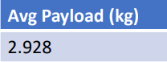
Average Payload Mass by F9 v1.1
Calculate the average payload mass carried by booster version F9 v1.1
Filtering data by the booster version above and calculating the average payload mass we obtained the value of 2,928 kg.

Slide 28
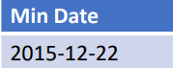
First Successful Ground Landing Date
Find the dates of the first successful landing outcome on ground pad
By filtering data by successful landing outcome on ground pad and getting the minimum value for date it’s possible to identify the first occurrence, that happened on 12/22/2015.

Slide 29
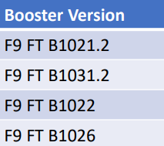
Successful Drone Ship Landing with Payload between 4000 and 6000
List the names of boosters which have successfully landed on drone ship and had payload mass greater than 4000 but less than 6000
Selecting distinct booster versions according to the filters above, these 4 are the result.

Slide 30
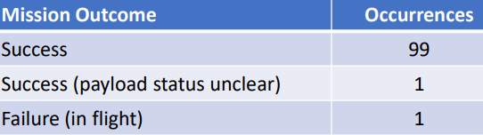
Total Number of Successful and Failure Mission Outcomes
Calculate the total number of successful and failure mission outcomes
Grouping mission outcomes and counting records for each group led us to the summary above.

Slide 31
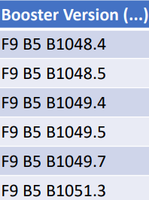
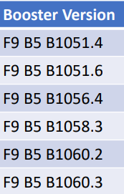
Boosters Carried Maximum Payload
List the names of the booster which have carried the maximum payload mass
These are the boosters which have carried the maximum payload mass registered in the dataset.

Slide 32
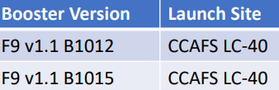
2015 Launch Records
List the failed landing_outcomes in drone ship, their booster versions, and launch site names for in year 2015
The list above has the only two occurrences.

Slide 33
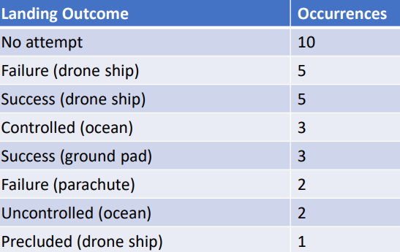
Rank Landing Outcomes Between 2010-06-04 and 2017-03-20
Rank the count of landing outcomes (such as Failure (drone ship) or Success (ground pad)) between the date 2010-06-04 and 2017-03-20, in descending order
This view of data alerts us that “No attempt” must be taken in account.

Slide 34

Section 3

Slide 35
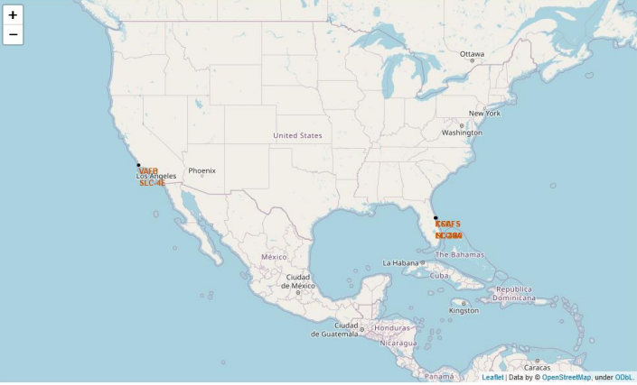
All launch sites
Launch sites are near sea, probably by safety, but not too far from roads and railroads.

Slide 36
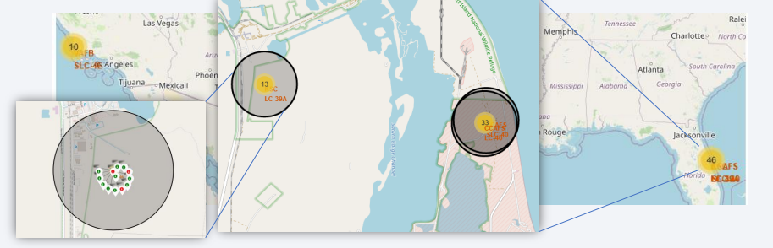
Launch Outcomes by Site
Green markers indicate successful and red ones indicate failure.

Slide 37
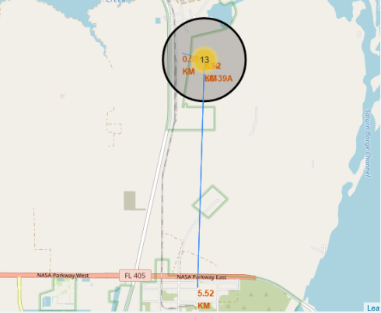
Logistics and Safety
Launch site KSC LC-39A has good logistics aspects, being near railroad and road and relatively far from inhabited areas.

Slide 38

Section 4

Slide 39
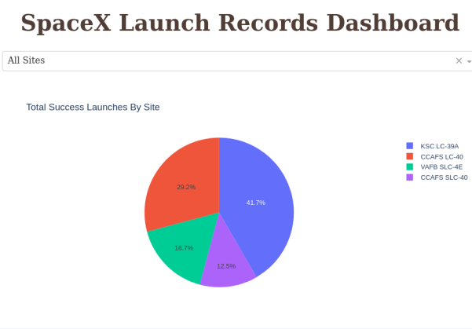
Successful Launches by Site

Slide 40
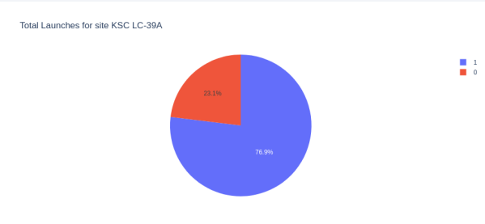
Launch Success Ratio for KSC LC-39A
• 76.9% of launches are successful in this site.

Slide 41
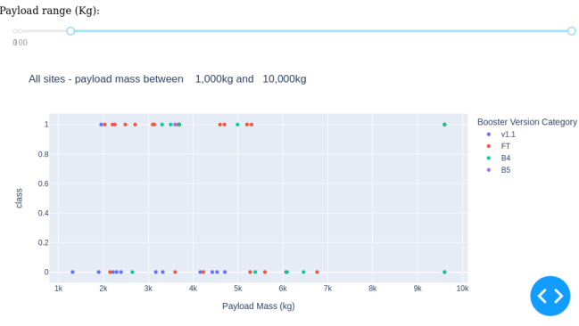
Payload vs. Launch Outcome
• Payloads under 6,000kg and FT boosters are the most successful combination.

Slide 42

Section 5

Slide 43
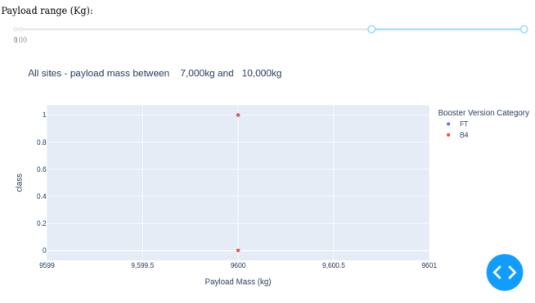
Classification Accuracy
• There’s not enough data to estimate risk of launches over 7,000kg

Slide 44
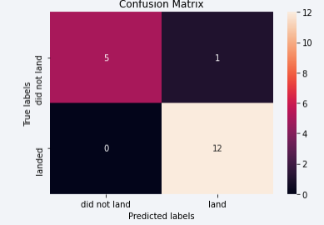
Confusion Matrix
Confusion matrix of Decision Tree Classifier proves its accuracy by showing the big numbers of true positive and true negative compared to the false ones.

Slide 45
Conclusions
Different data sources were analyzed, refining conclusions along the process.
The best launch site is KSC LC-39A.
Launches above 7,000kg are less risky.
Although most of mission outcomes are successful, successful landing outcomes seem to improve over time, according the evolution of processes and rockets.
Decision Tree Classifier can be used to predict successful landings and increase profits

Slide 46
Appendix
Include any relevant assets like Python code snippets, SQL queries, charts, Notebook outputs, or data sets that you may have created during this project

Slide 47


